Slide 1
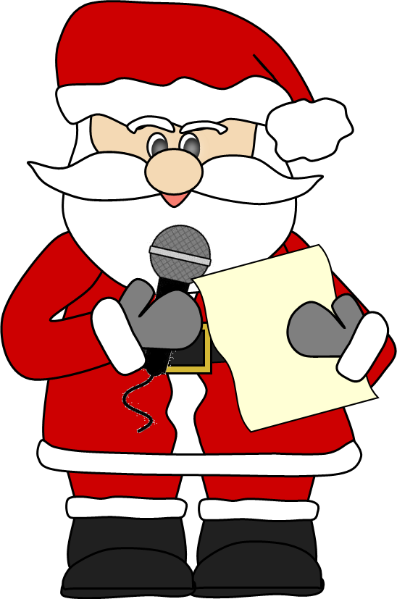
The 2020 Christmas Quiz
For KS2

Slide 2
The 2020 Christmas Quiz
Welcome to The 2020 Christmas Quiz. The quiz is made up of eight rounds:
Secret Santa
Christmas Crackers
That Was the Year That Was
Advent Anagrams
Christmas Songs
Christmas Close Up
Christmas at the Movies
Festive Spot the Difference

Slide 3
Rules
Before we begin, we’re going to outline the rules.
Teams will be made up of four.
Each team must have a name linked to the Christmas theme. Bonus points will be awarded for the best team names.
Bonus points will also be awarded for teams who communicate maturely and work together quietly.
Teams will have points deducted if they are too noisy or bad sports.
If, by the end of the quiz, teams are one the same points, there will be a tie break to decide the winner.

Slide 4
Round One
Secret Santa
Can you identify the celebrity dressed as Santa?

Slide 5
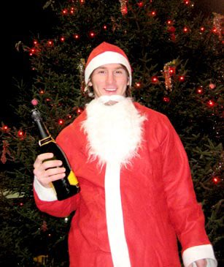
1.

Slide 6
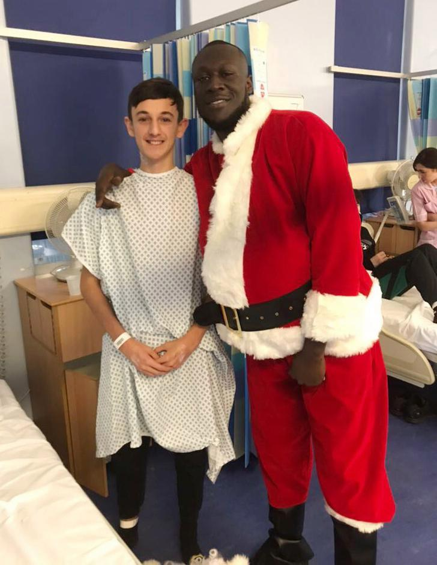
2.

Slide 7
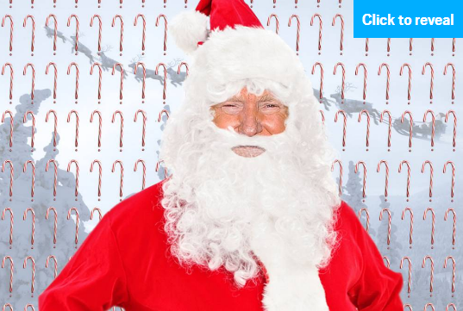
3.

Slide 8
4.

Slide 9
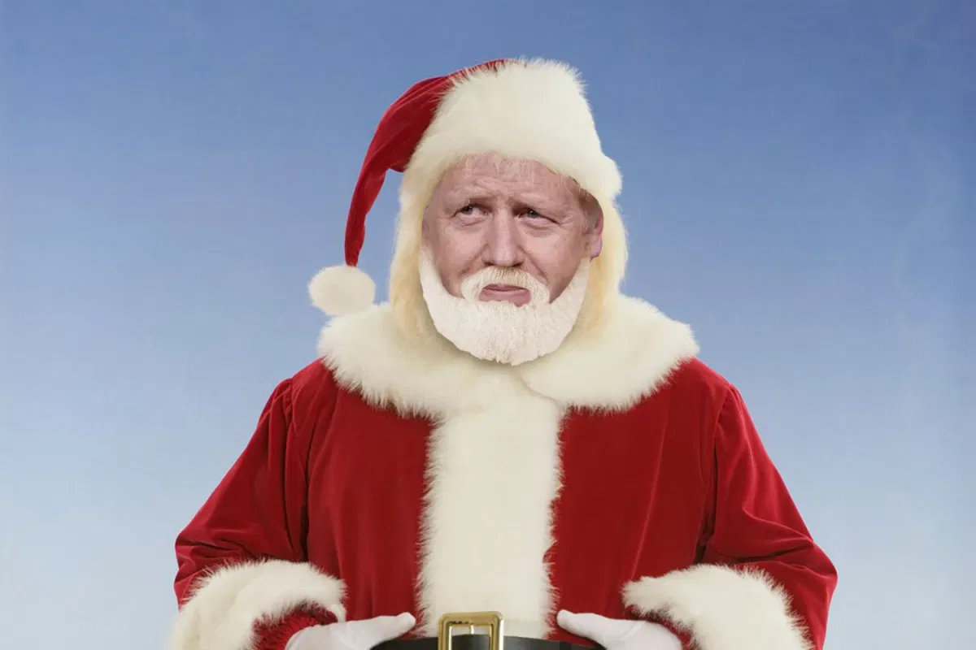
5.

Slide 10
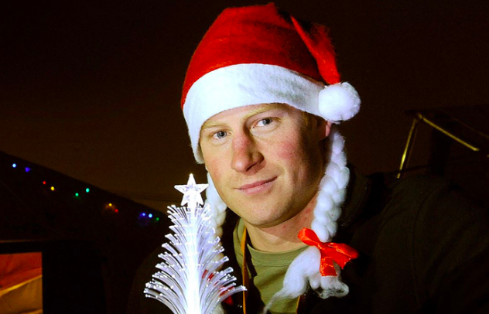
6.

Slide 11
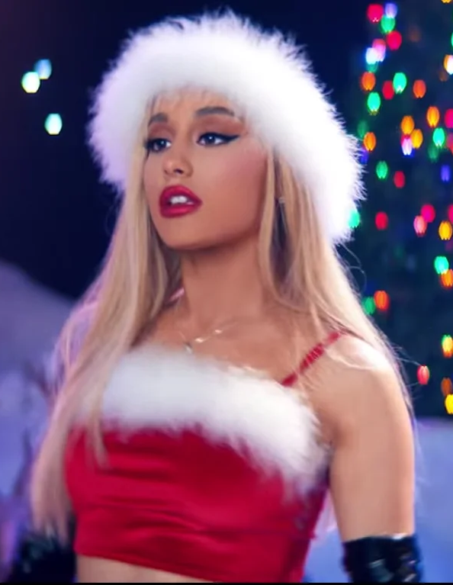
7.

Slide 12
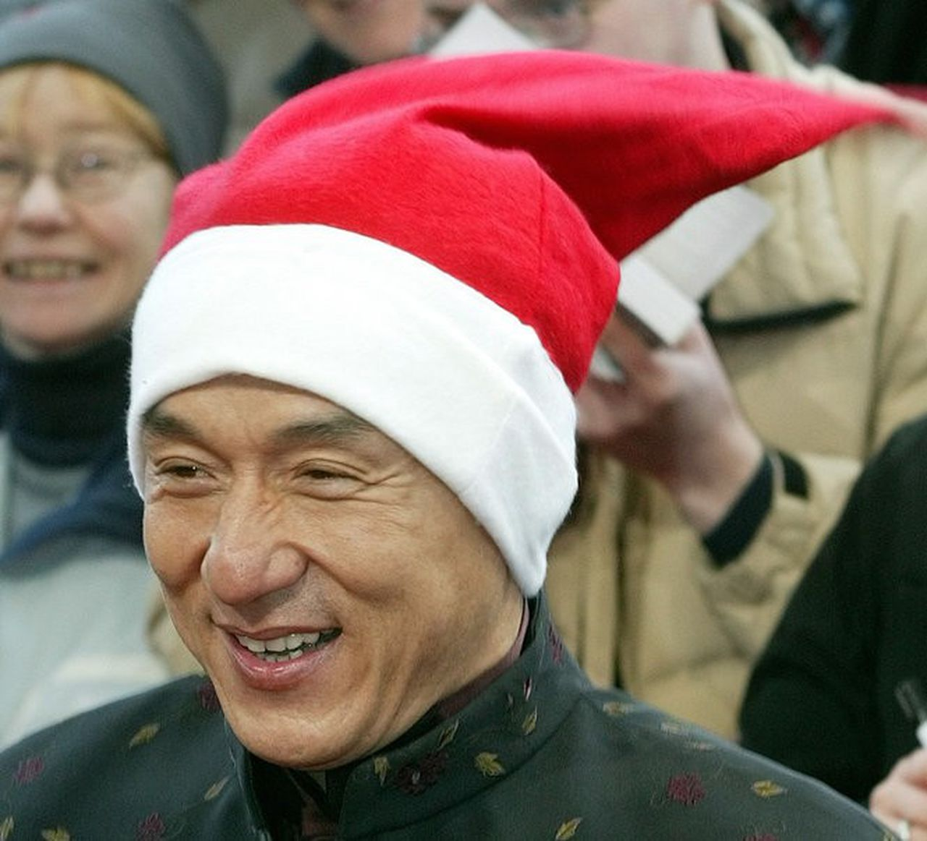
8.

Slide 13
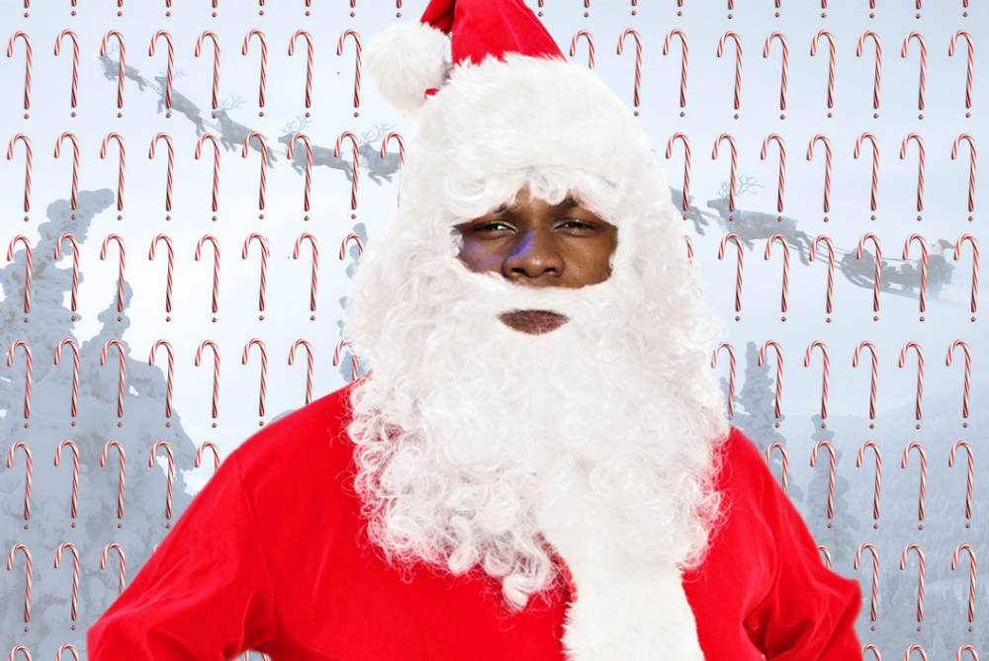
9.

Slide 14
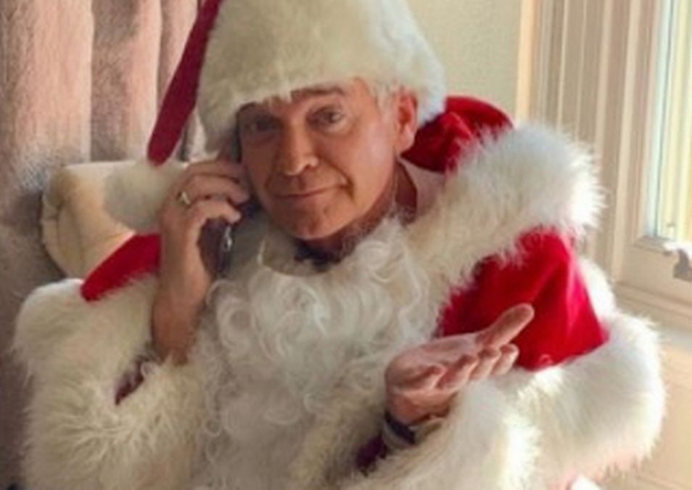
10.

Slide 15
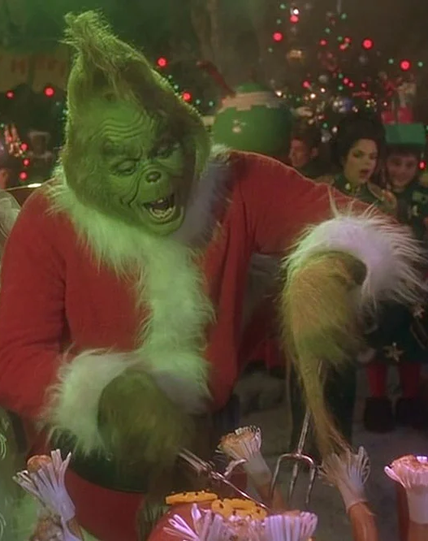
11.

Slide 16
12.

Slide 17
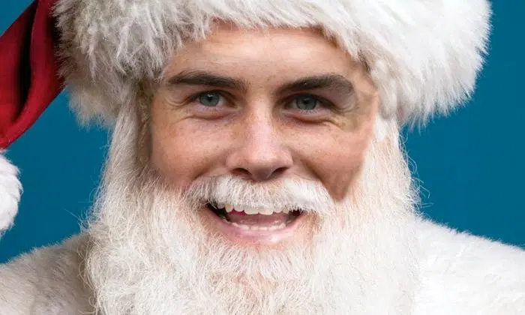
13.

Slide 18
Round Two
Christmas Crackers
Ten Christmas themed questions

Slide 19
Question one
In the film The Snowman, what colour is the Snowman’s
scarf?
(If no group is correct, the closest get the point)

Slide 20
Question Two
On which day of the week is Christmas Day this year?

Slide 21
Question Three
Dr Seuss's The Grinch attempts to steal Christmas from which unsuspecting town?

Slide 22
Question Four
What are the names of the two children in the film Christmas Chronicles?

Slide 23
Question Five
How old is Kevin McCallister in Home Alone?

Slide 24
Question Six
In the movie Elf, what's the first rule in the Code of The Elves?

Slide 25
Question Seven
In Harry Potter and the Philosopher's Stone, what do the Dursleys give Harry for Christmas?

Slide 26
Question Eight
Which character declares "God bless Us, Every One!” at the end of Charles Dickens' A Christmas Carol?

Slide 27
Question Nine
What animated film depicts a train that takes children to the North Pole on Christmas Eve?

Slide 28
Question Ten
Stollen is the traditional Christmas fruit cake of which country?

Slide 29
Round 1 and Round 2 Answers

Slide 30
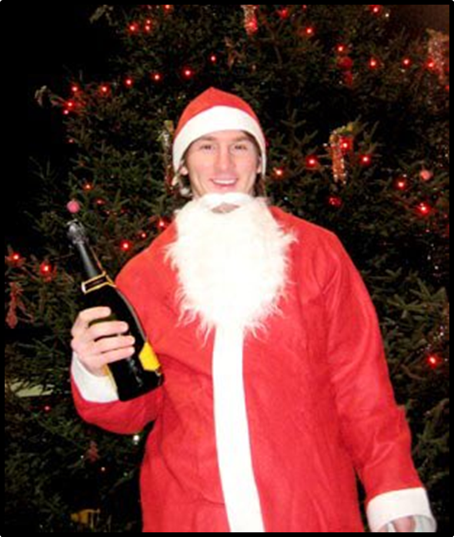
Lionel Messi
1.

Slide 31
2.
Stormzy

Slide 32
3.
Donald Trump

Slide 33
Taylor Swift
4.

Slide 34
5.
Boris Johnson

Slide 35
6.
Prince Harry

Slide 36
Ariana Grande
7.

Slide 37
Jackie Chan
8.

Slide 38
9.
John Boyega

Slide 39
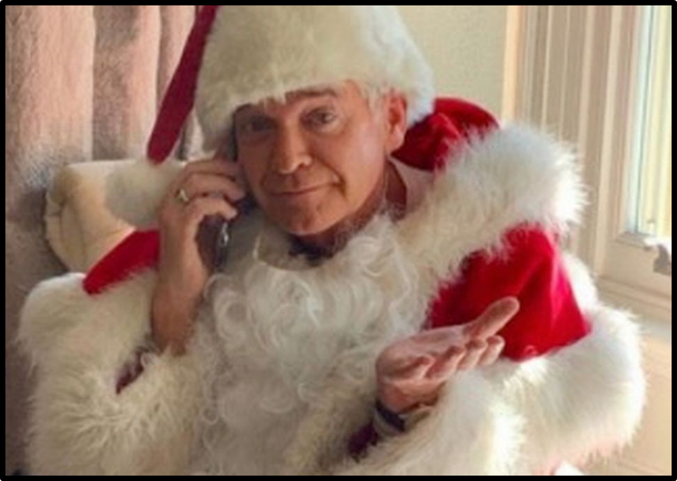
10.
Phillip Schofield

Slide 40
The Grinch
11.
(Bonus point for Jim Carrey)

Slide 41
Billie Eilish
12.

Slide 42
13.
Gareth Bale

Slide 43
Question one
In the film The Snowman, what colour is the Snowman’s
scarf?
Green
(If no group is correct, the closest get the point)

Slide 44
Question Two
On which day of the week is Christmas Day this year?
Friday

Slide 45
Question Three
Dr Seuss's The Grinch attempts to steal Christmas from which unsuspecting town?
Whoville

Slide 46
Question Four
What are the names of the two children in the film Christmas Chronicles?
Teddy and Katie

Slide 47
Question Five
How old is Kevin McCallister in Home Alone?
8

Slide 48
Question Six
In the movie Elf, what's the first rule in the Code of The Elves?
Treat Every Day like Christmas

Slide 49
Question Seven
In Harry Potter and the Philosopher's Stone, what do the Dursleys give Harry for Christmas?
A 50-pence piece

Slide 50
Question Eight
Which character declares "God bless Us, Every One!” at the end of Charles Dickens' A Christmas Carol?
Tiny Tim

Slide 51
Question Nine
What animated film depicts a train that takes children to the North Pole on Christmas Eve?
The Polar Express

Slide 52
Question Ten
Stollen is the traditional Christmas fruit cake of which country?
Germany

Slide 53
Round Three
That Was the Year That Was
How much were you paying attention in 2020?

Slide 54
Question One
Which team won the Premier League in 2020?

Slide 55
Question Two
Which 99 year old war veteran was awarded a knighthood in recognition of his fundraising efforts for the NHS?

Slide 56
Question Three
Where were the 2020 Olympics supposed to be held?

Slide 57
Question Four
What does W.H.O. stand for?

Slide 58
Question Five
Why did Boris Johnson go to Hospital in April?

Slide 59
Question Six
Laga Gaga teamed up with which superstar on the track 'Rain on Me'?

Slide 60
Question Seven
Who defeated Donald Trump in the US Election in November 2020?

Slide 61
Question Eight
Which basketball star died in a helicopter crash?

Slide 62
Question Nine
In January, who announced they are stepping down from their duties as senior members of the royal family?

Slide 63
Question Ten
Thousands of people protested against the death of a black man arrested by police in the USA, what was his name?

Slide 64
Round Four
Advent Anagrams
You will be shown ten words and phrases associated with Christmas in anagram form. Each one has a clue in brackets. Can you unscramble the anagrams?

Slide 65
rematch starfish (Saint Nicholas)
reck scar (table decoration)
epic mines (type of food)
kitted lonely (Christmas carol)
hamsters vice (a special day)
red ernie (Comet, for example)
ivy titan (the birth of Jesus)
pinking stables (type of food)
action doers (these are put up at Christmas)
ace openheart (and goodwill to all men)

Slide 66
Round 3 and Round 4 Answers

Slide 67
Question One
Which team won the Premier League in 2020?
Liverpool

Slide 68
Question Two
Which 99 year old war veteran was awarded a knighthood in recognition of his fundraising efforts for the NHS?
Captain Sir Tom Moore

Slide 69
Question Three
Where were the 2020 Olympics supposed to be held?
Tokyo

Slide 70
Question Four
What does W.H.O. stand for?
World Health Organisation

Slide 71
Question Five
Why did Boris Johnson go to Hospital in April?
He caught Coronavirus

Slide 72
Question Six
Lady Gaga teamed up with which superstar on the track 'Rain on Me'?
Ariana Grande

Slide 73
Question Seven
Who defeated Donald Trump in the US Election in November 2020?
Joe Biden

Slide 74
Question Eight
Which basketball star died in a helicopter crash?
Kobe Bryant

Slide 75
Question Nine
In January, who announced they are stepping down from their duties as senior members of the royal family?
Megan and Harry

Slide 76
Question Ten
Thousands of people protested against the death of a black man arrested by police in the USA, what was his name?
George Floyd

Slide 77
rematch starfish
reck scar
epic mines
kitted lonely
hamsters vice
red ernie
ivy titan
pinking stables
action doers
ace openheart
Father Christmas
Crackers
Mince Pies
Little Donkey
Christmas Eve
Reindeer
Nativity
Pigs in Blankets
Decorations
Peace on Earth

Slide 78
Round Five
Christmas Songs
Click the link below to play the Christmas Songs Quiz
LINK
Listen to the intros from 21 Christmas Songs. Can you name the song? You get 1 point for each correct answer. Answers are provided after each question.

Slide 79
Round Six
Christmas Close Ups
Can you name the following eight things from an extreme close up of each one?
They all have a Christmas connection.

Slide 80
1.

Slide 81
2.

Slide 82
3.

Slide 83
4.

Slide 84
5.

Slide 85
6.

Slide 86
7.

Slide 87
8.

Slide 88
Round 6 Answers

Slide 89
1.

Slide 90
2.

Slide 91
3.

Slide 92
4.

Slide 93
5.

Slide 94
6.

Slide 95
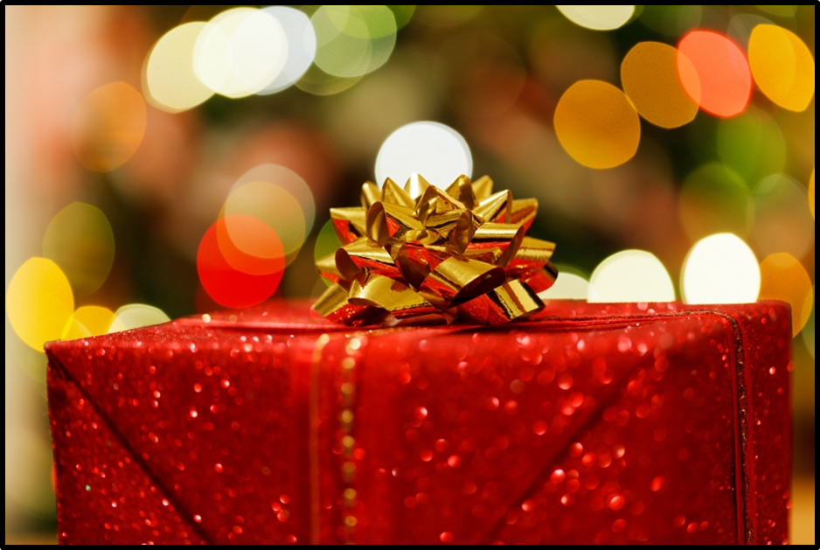
7.

Slide 96
8.

Slide 97
Round Seven
Christmas at the Movies
Click the link below to play the Christmas Film Quiz
Christmas Film Quiz
There are ten questions in total. The video asks for the year too, but ignore that. Your task is to just name each film.
Notes:
Here is an alternative movie quiz which may be more suitable - depending on the children that you teach - https://www.youtube.com/watch?v=Hb6jTerqf6k

Slide 98
Round Eight
Festive Spot the Difference
You have one minute to spot as many differences as you can in the following images.
There are 5 in total.

Slide 99
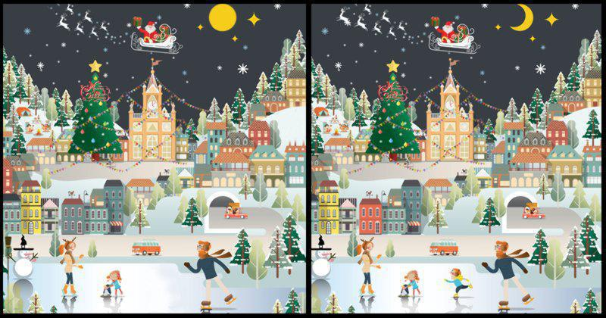

Slide 100
Round 7 & 8 Answers

Slide 101
Round Seven
Christmas at the Movies - Answers
How the Grinch Stole Christmas
Jingle All the Way
3. Arthur Christmas
4. Miracle on 34th Street
5. The Muppet Christmas Carol
6. The Nightmare Before Christmas
7. Scrooged
8. Elf
9. Home Alone
10. Die Hard

Slide 102
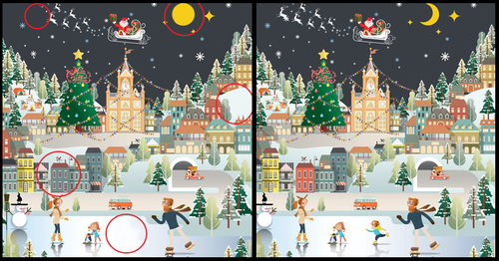
Spot the Difference
Answers

Slide 103
Tie Breaker Questions
To the nearest year, when were Christmas Lights first invented?
On the original Band Aid single ‘Do They Know It's Christmas?’, how many people were in the original line-up?
In what year was the first Christmas card produced?
How many words are there in the novel ‘A Christmas Carol’ by Charles Dickens?
Notes:
Four possible tie-break questions. Answers – 1. 1882 2. 40 3. 1843 4. 38,000. The nearest is the winner.

Slide 104
Teacher-of-Primary.com
Round 1
Round 2
_____________________________
_____________________________
_____________________________
_____________________________
_____________________________
_____________________________
_____________________________
_____________________________
_____________________________
_____________________________
_____________________________________________
_____________________________________________
_____________________________________________
_____________________________________________
_____________________________________________
_____________________________________________
_____________________________________________
_____________________________________________
_____________________________________________
_____________________________________________
_____________________________________________
_____________________________________________
_____________________________________________
Copyright 2020 Online Teaching Resources Ltd
Notes:
Worksheet

Slide 105
Teacher-of-Primary.com
Round 3
Round 4
_____________________________________________
_____________________________________________
_____________________________________________
_____________________________________________
_____________________________________________
_____________________________________________
_____________________________________________
_____________________________________________
_____________________________________________
_____________________________________________
_____________________________
_____________________________
_____________________________
_____________________________
_____________________________
_____________________________
_____________________________
_____________________________
_____________________________
_____________________________
Copyright 2020 Online Teaching Resources Ltd
Notes:
Worksheet

Slide 106
Teacher-of-Primary.com
Round 5
______________________________________________________________
______________________________________________________________
______________________________________________________________
______________________________________________________________
______________________________________________________________
______________________________________________________________
______________________________________________________________
______________________________________________________________
______________________________________________________________
______________________________________________________________
______________________________________________________________
Copyright 2020 Online Teaching Resources Ltd
Notes:
Worksheet

Slide 107
Teacher-of-Primary.com
Round 5
______________________________________________________________
______________________________________________________________
______________________________________________________________
______________________________________________________________
______________________________________________________________
______________________________________________________________
______________________________________________________________
______________________________________________________________
______________________________________________________________
______________________________________________________________
Copyright 2020 Online Teaching Resources Ltd
Notes:
Worksheet

Slide 108
Teacher-of-Primary.com
Round 6
Round 7
_____________________________
_____________________________
_____________________________
_____________________________
_____________________________
_____________________________
_____________________________
_____________________________
_____________________________________________
_____________________________________________
_____________________________________________
_____________________________________________
_____________________________________________
_____________________________________________
_____________________________________________
_____________________________________________
_____________________________________________
_____________________________________________
Copyright 2020 Online Teaching Resources Ltd
Notes:
Worksheet

Slide 109
Teacher-of-Primary.com
Round 8
Copyright 2020 Online Teaching Resources Ltd
Notes:
Worksheet

