Slide 1
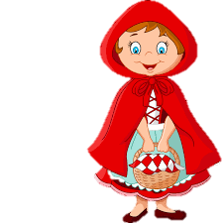
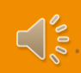

When you see a little speaker, click on it to listen.

Slide 2
Little Red Riding Hood wants to find out ‘Why Is Food Important?’

Slide 3
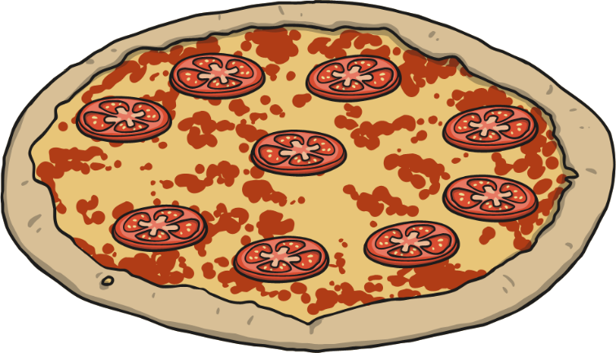
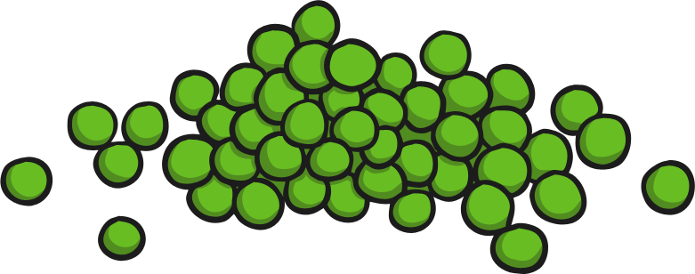

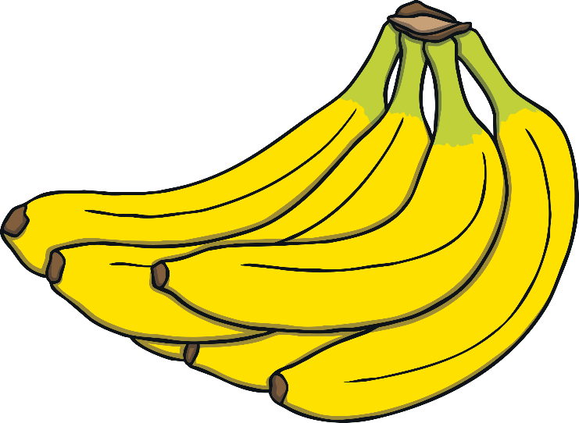
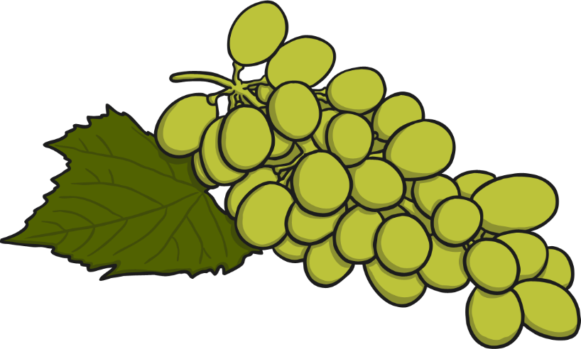
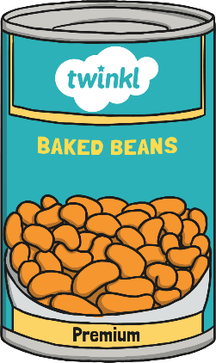
Why Is Food Important?
We need food to stay healthy.
Some foods are healthier than others.
It is important to eat lots of the healthy foods and less of
the unhealthy foods.

Slide 4
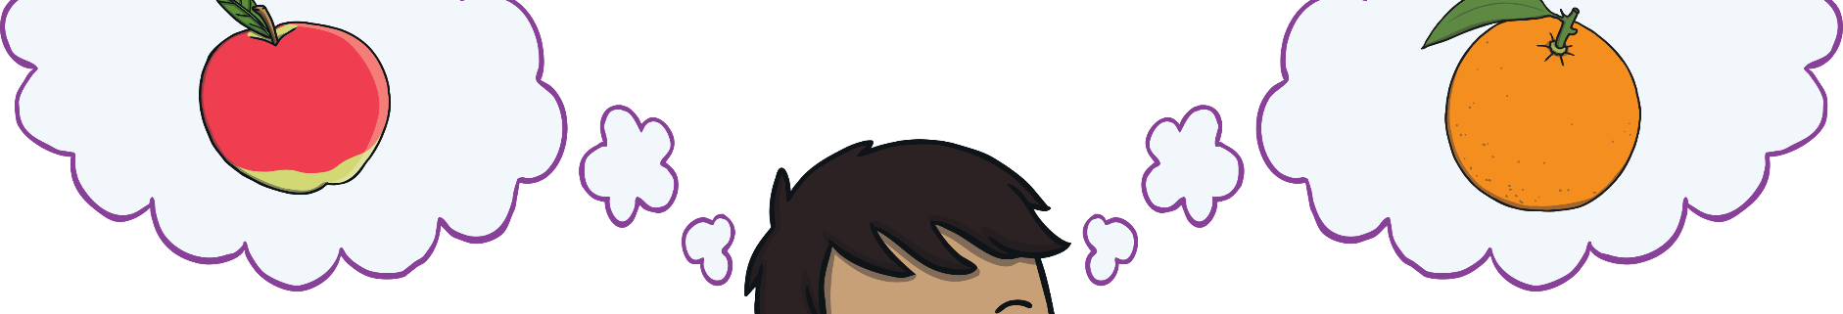
Healthy Eating
What foods do you think are healthy?

Slide 5
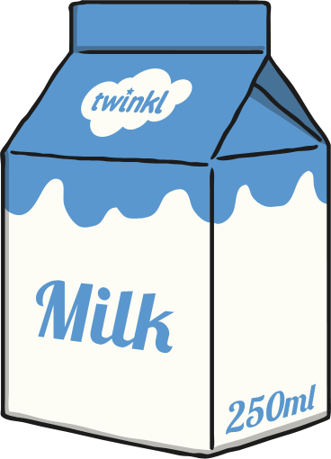
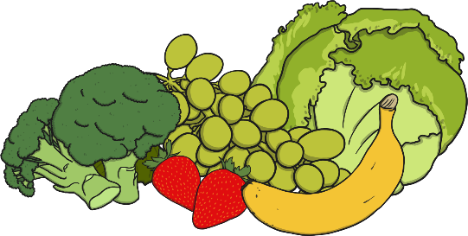
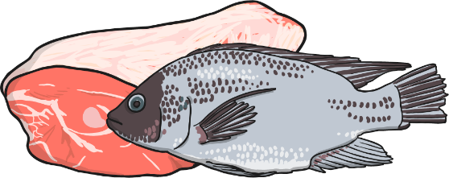
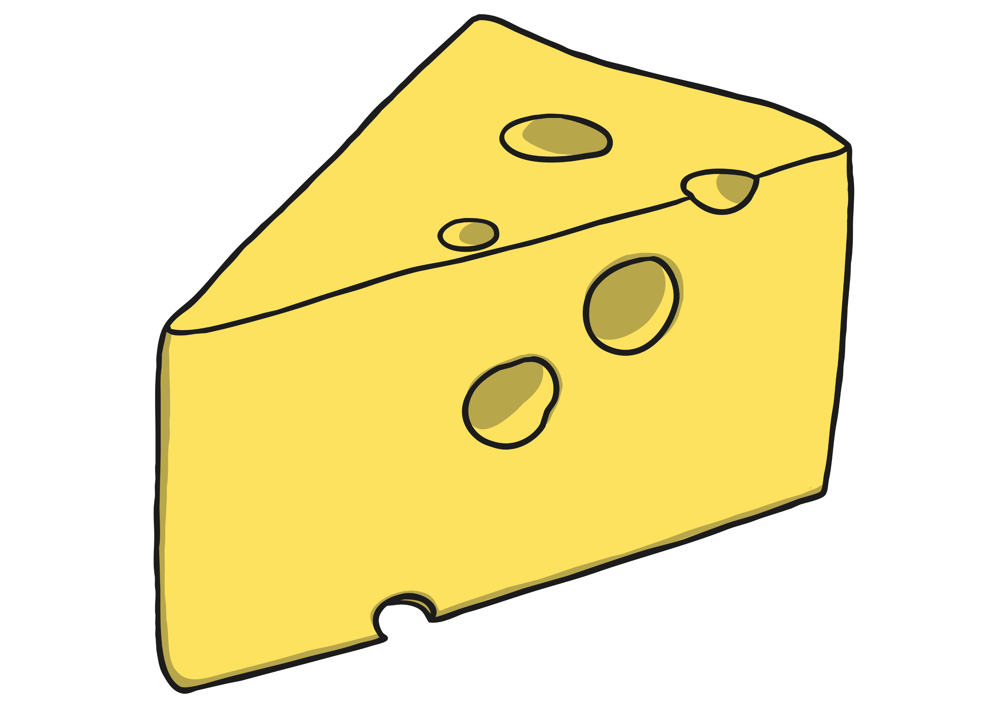
Healthy Eating
It is healthy to eat lots of these types of foods.
fruit and vegetables
fish and meat
milk and cheese

Slide 6
Fruits and Vegetables
We should aim to eat five portions of fruit and vegetables every day.
Fruit contains lots of good vitamins and minerals that help you feel healthy and give you lots of energy.
Fruits and vegetables, such as broccoli, oranges and tomatoes, contain lots of vitamin C, which helps us get better if we are poorly.

Slide 7
Fish and Meat
Fish and Meat contain lots of protein.
Protein is important because it helps your body heal any cuts. It also helps your hair and nails grow strong.

Slide 8
Milk and Cheese
Milk and cheese are dairy foods.
Dairy foods contain lots of calcium. Calcium helps your bones and teeth stay strong.

Slide 9
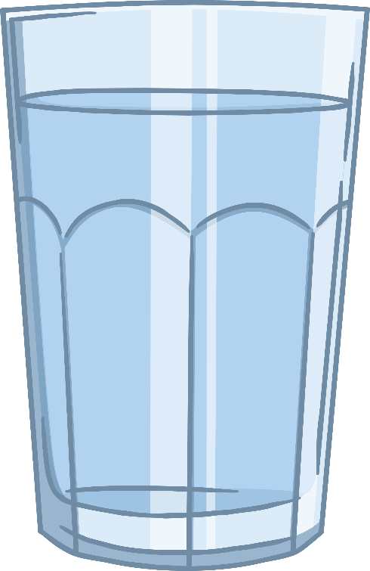
Healthy Eating
We should try to drink plenty of water every day.
Water has lots of good things our body needs to stay healthy.
We can feel poorly if we don’t drink enough water.

Slide 10
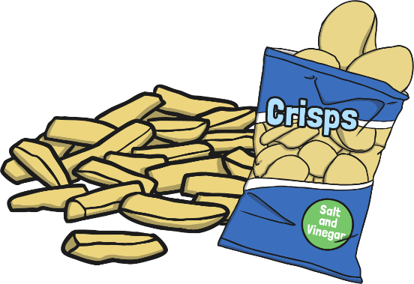
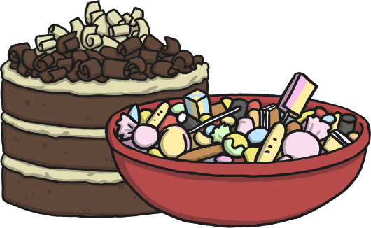

Healthy Eating
To stay healthy, we should eat less of these types of foods.
Its perfectly fine to eat a little bit of unhealthy food but eating too much can make us overweight and poorly.
cakes and sweets
chocolate
chips and crisps

Slide 11
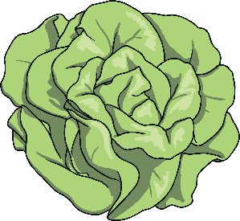
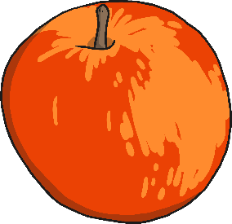


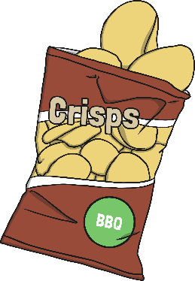
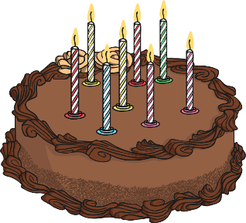

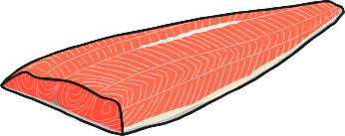

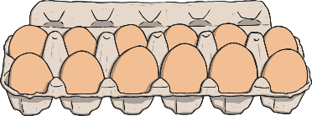
Healthy or Unhealthy?
Healthy foods | Unhealthy foods

Slide 12



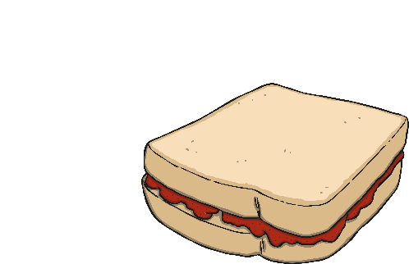
Healthy Lunch
Do you think my lunch is healthy?
What could you change to make it more healthy?
chocolate bar
fizzy drink
jam sandwich
crisps

Slide 13
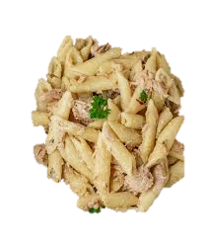
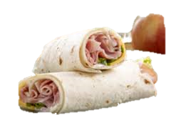
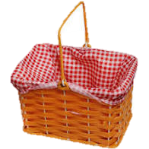



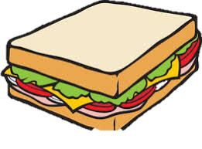

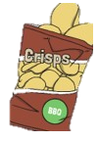

Grandma's Picnic Basket Lunch
Grandma has not been feeling very well. She needs a healthy lunch to help her get better. Could you help Little Red Riding Hood to choose a balanced meal for her. Click on the images to add them to your basket.

Slide 14
Congratulations you have helped Little Red Riding Hood learn more about Healthy Food!

