Slide 1
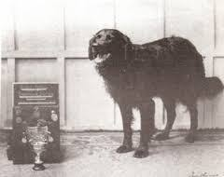
Jac Abertawe
J
A
C
A
B
E
R
T
A
W
E

