Slide 1
Science
Scientists and Inventors
Science | Year 5 | Scientists and Inventors | Mission to the Moon | Lesson 3

Slide 3
Aim
To describe how space travel has changed over time.
Success Criteria
I can order key dates in space travel on a timeline.
I can explain how Margaret Hamilton programmed the Apollo spacecrafts.
I can explain how Margaret Hamilton’s work changed people’s ideas.

Slide 4
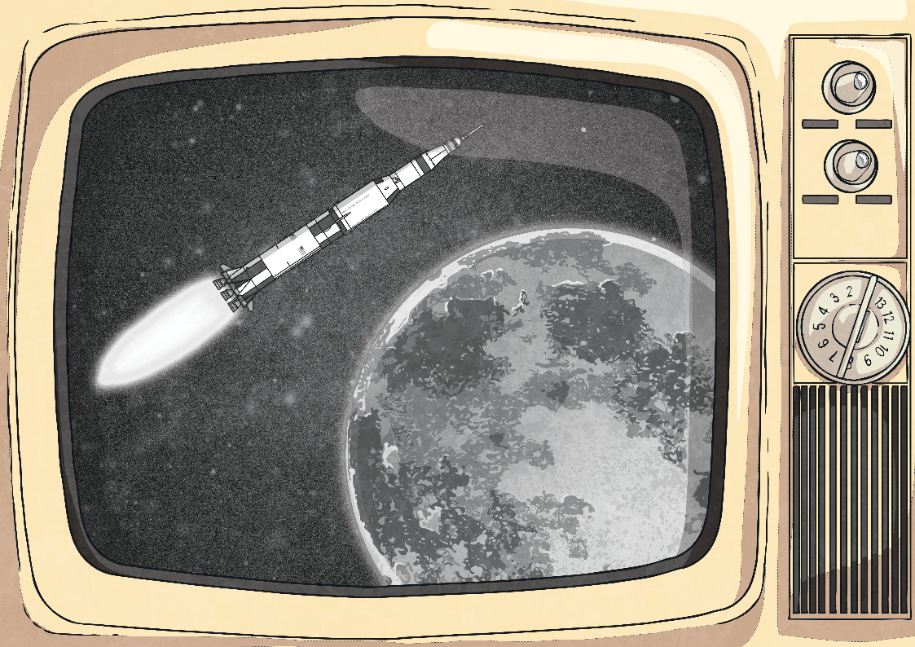
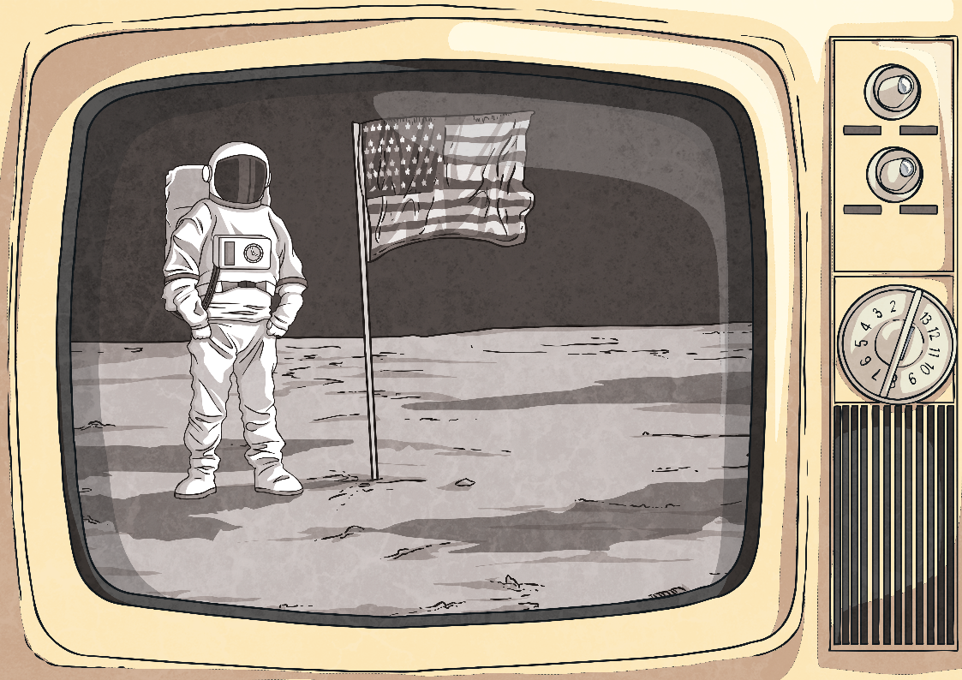
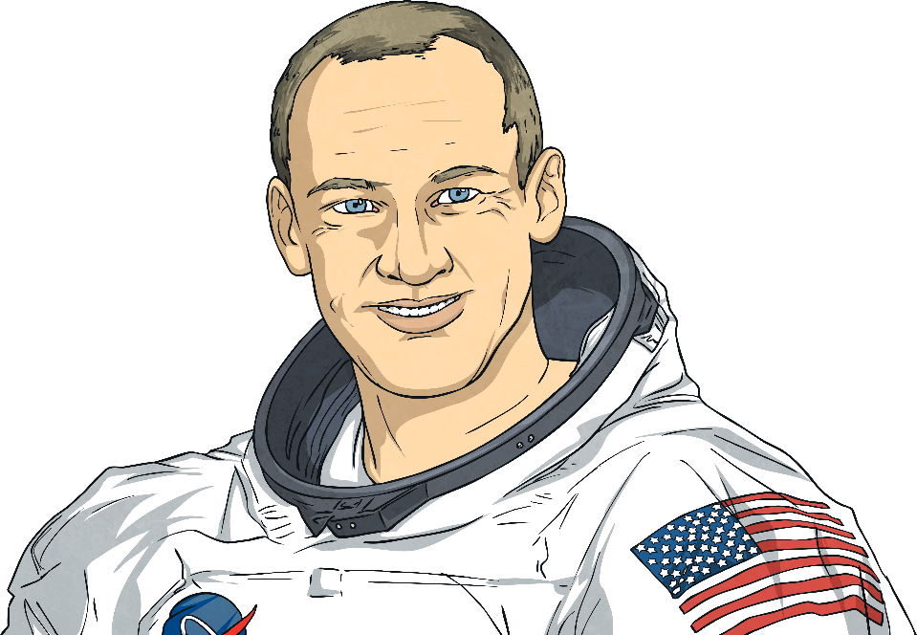
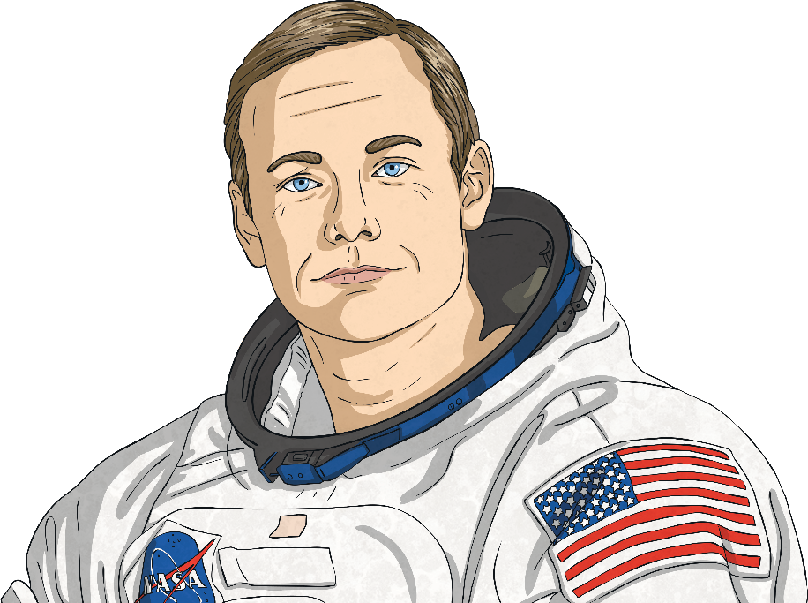
Mission to the Moon
On the 20th July 1969, the Apollo 11 spacecraft landed on the Moon. Inside the spacecraft were astronauts including Neil Armstrong and Buzz Aldrin.
The following day, Armstrong and Aldrin became the first people to ever set foot on the Moon.
How did they get there? How did their spacecraft manage to fly from our Earth to the Moon? How did it land safely?

Slide 5
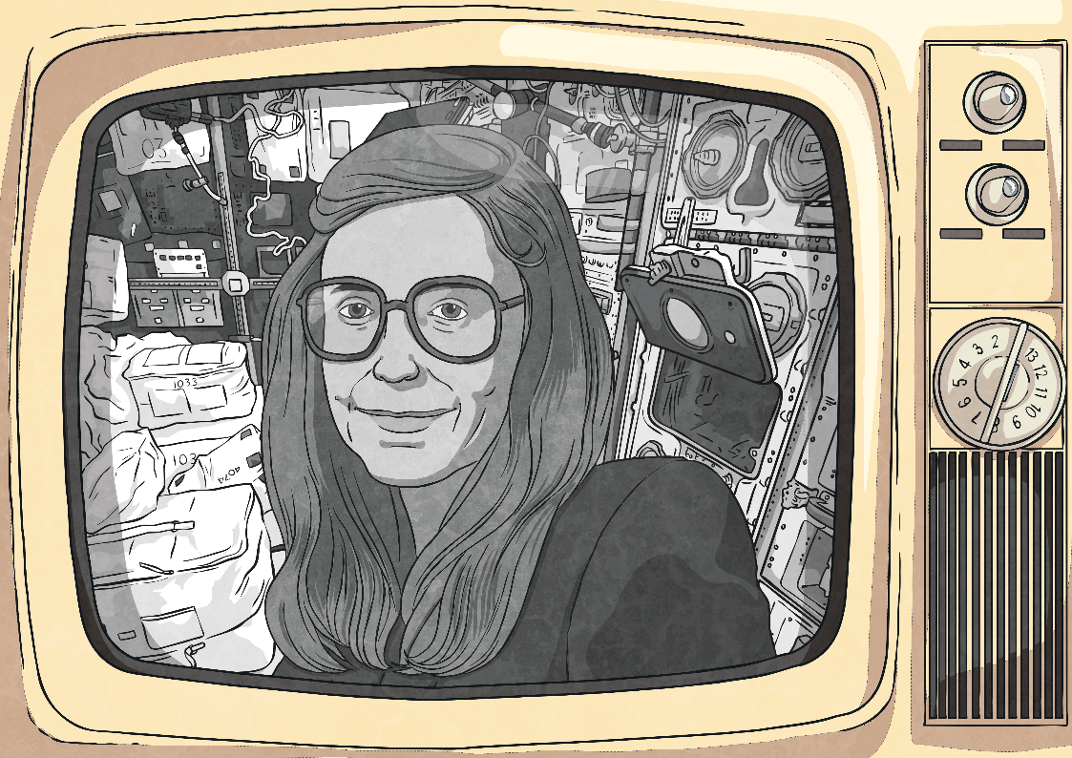
Margaret Hamilton
The answer to all these questions is the work of one person - Margaret Hamilton.
Hamilton worked at NASA, and was responsible for programming the on-board flight software on the Apollo computers.
She wrote the code that the computer used to navigate from Earth to the Moon, and made sure that the computer would land the spacecraft safely on the surface of the Moon.

Slide 6
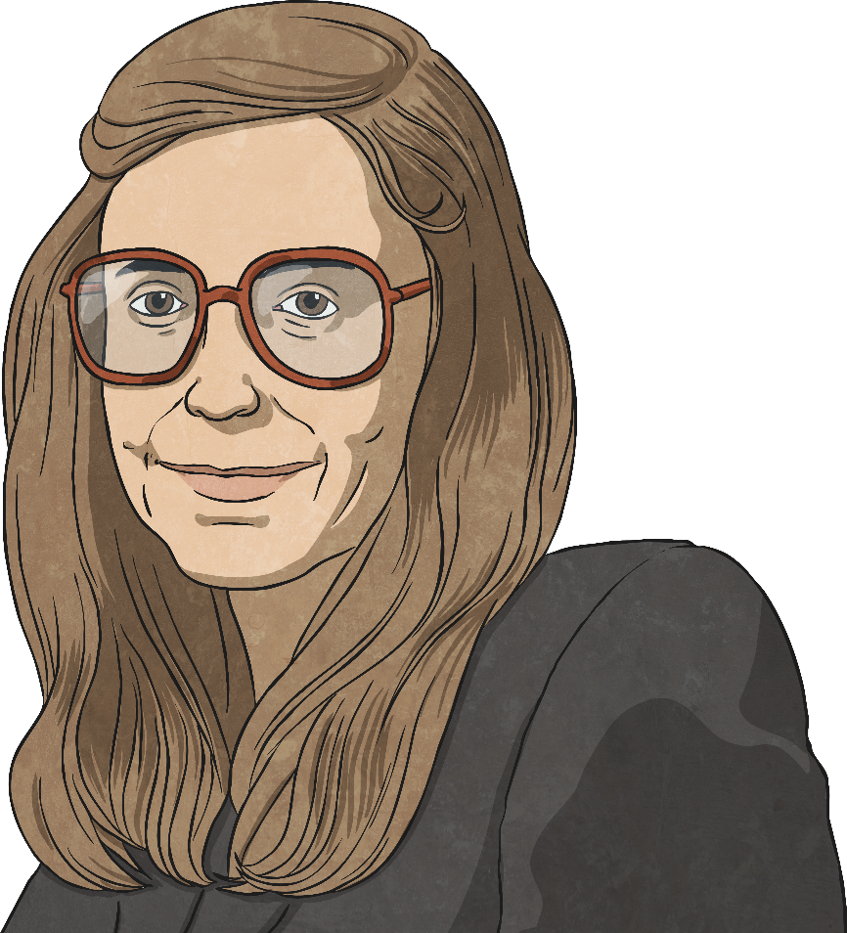
Hamilton’s Success
A moment that Hamilton has described as one of her biggest successes is the moment the Apollo 11 spacecraft landed on the Moon.
A radar had been mistakenly switched on, so the computer was receiving too much information. It could not land safely while this was happening.
Just minutes before the shuttle landed, the Apollo computer started sending error messages and alarms. Something was wrong.
Fortunately, Hamilton had written a special computer program that saved the mission. The computer knew it was becoming overloaded, so it could eliminate the radar information and focus on landing.
If Hamilton had not added this code, the computer would have crashed and the Apollo landing would not have succeeded.
ERROR

Slide 7
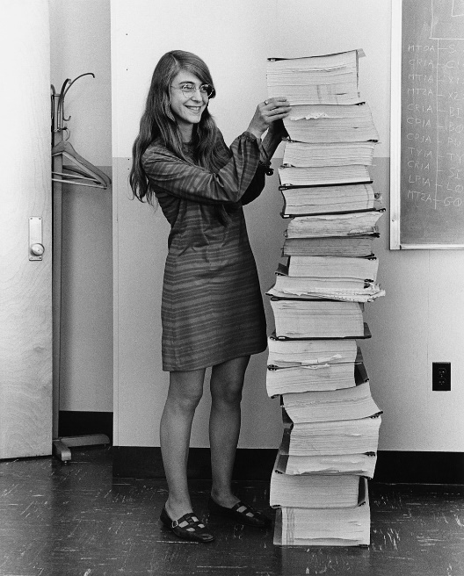
Margaret Hamilton’s Legacy
Margaret Hamilton worked on every one of the Apollo manned flights and several unmanned ones. Her work in computer engineering set the standard for the use of computers in space travel.
manned
any mission which had astronauts on board a craft
Her work made many future space missions, and other forms of flight, possible.
Margaret Hamilton with stacks of her own coding.

Slide 8
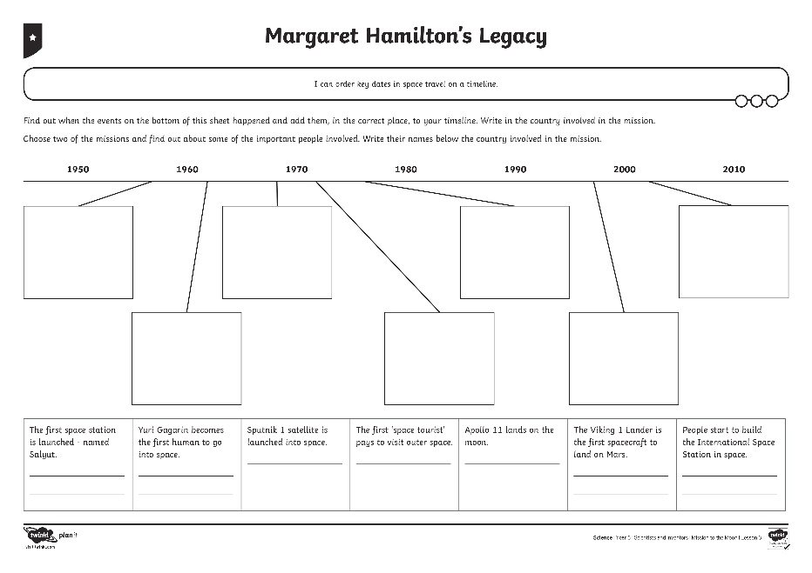
Margaret Hamilton’s Legacy
Use computer research to correctly order and explain some of the most important events in space travel on the Space Travel Timeline.

Slide 9
How Have Things Changed?
Margaret Hamilton was the first person to really understand how software and computer programs could be used to make things happen.
How are things different today?
How did Hamilton's work change things?
Can you think of ways software and computer programs are used today?
She referred to herself as a software engineer. At that time, there were no earlier software projects to learn from, or classes in software engineering. Hamilton taught herself everything.

Slide 10
Aim
To describe how space travel has changed over time.
Success Criteria
I can order key dates in space travel on a timeline.
I can explain how Margaret Hamilton programmed the Apollo spacecrafts.
I can explain how Margaret Hamilton’s work changed people’s ideas.

