Slide 2
Lesson Aims
Learning about the Hen Galan tradition.
Discuss what people in the past did to celebrate and wish luck for the year to come.

Slide 3
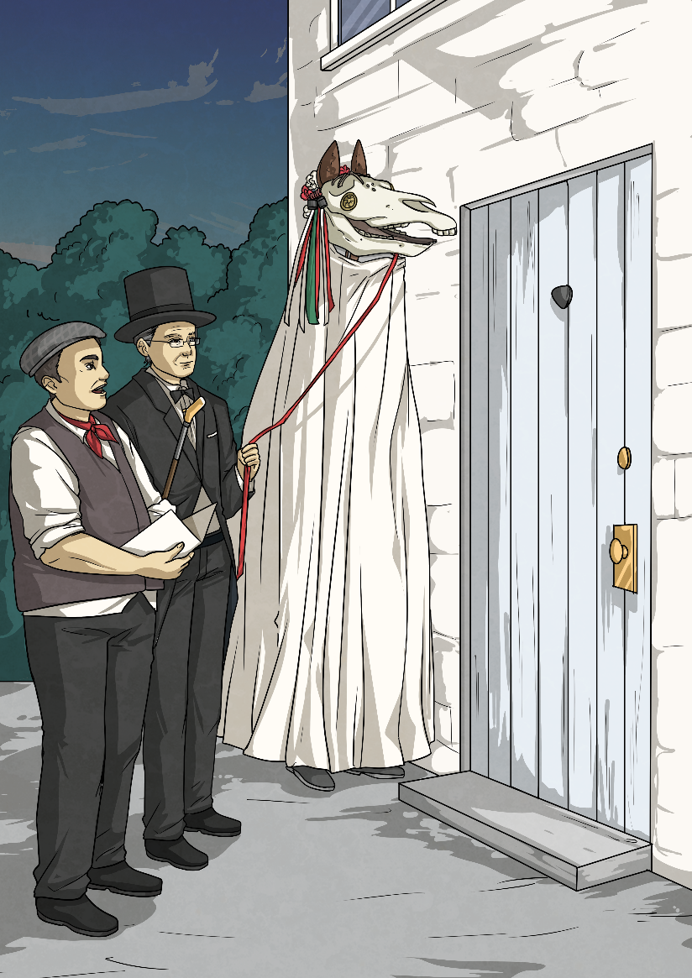
The Mari Lwyd
The Mari Lwyd was one of the strangest traditions of the Hen Galan (New Year).
It was a horse’s skull covered in a sheet, ribbons and bells.
This was part of the wassailing tradition. People believed that the Mari Lwyd would bring good luck for the year to come. They would celebrate during December and January.
The skull was placed on a pole so that the person under the sheet would be able to open and close the mouth!

Slide 4
The Battle
The group would try to gain access to a house by singing a verse.
This was called ՙpwnco՚.
The homehold would then answer with their own rhyme in a fake battle to try to outwit the Mari Lwyd.
Once the battle was at an end they would allow the Mari Lwyd and the crew into the house, where they would enjoy refreshments. They would then go from house to house, repeating these actions.

Slide 5
Some Verses of the Mari Lwyd Song
Outside Group Wel dyma ni’n dwad,
gyfeillion diniwad,
I ofyn am gennad i ganu.
Household Group
O cerwch ar gered,
Mae’ch ffordd yn agored,
Mae’ch ffordd yn agored nos heno.
Outside Group
Os na chawn ni gannad,
Rhowch glywad ar ganiad,
Pa fodd ma’r ‘madawiad nos heno.
Outside Group
Nid awn ni ar gered,
Heb dorri ein syched,
Heb dorri ein sychad nos heno.
Outside Group
Ma’ Mari Lwyd yma,
A sêr a rhubana,
Yn werth i roi gola nos heno.
Household Group
Rhowch glywad, wyr ddoethion,
Pa faint y’ch o ddynion,
A beth yn wych union yw’ch enwau.

Slide 6
The Mari Lwyd Song Continued in the House
Mari Lwyd Party
Rhyw griw o wyr hawddgar,
Rhai gorau y ddaear,
Yn canu mewn gwir air am gwrw.
Household Response
Rhowch glywad, wir difrad
O ble ‘rych chi’n dwad,
A beth yw’ch gofyniad gewch enwi.
O tynnwch y bollta
Agorwch y drysa,
I fois y gwaseila rhowch groeso.
Mi dynnwn y bollta
Agorwn y drysa’,
I fois y gwaseila ma’ croeso.

Slide 7
What Does the Song Mean?
It continues with them asking the householder to unlock the door for them to gain admittance.
They are asking for entry into the house.
The people inside the house are telling them to go away and then there begins a ‘singing’ battle between the two parties.
Eventually the householder decides to let them in and the celebrations continue within and the party are offered refreshments.
The members of the party outside answer, saying that they will not go away until they have had a drink to quench their thirst. The household asks them who they are and how many are in their party.

Slide 8
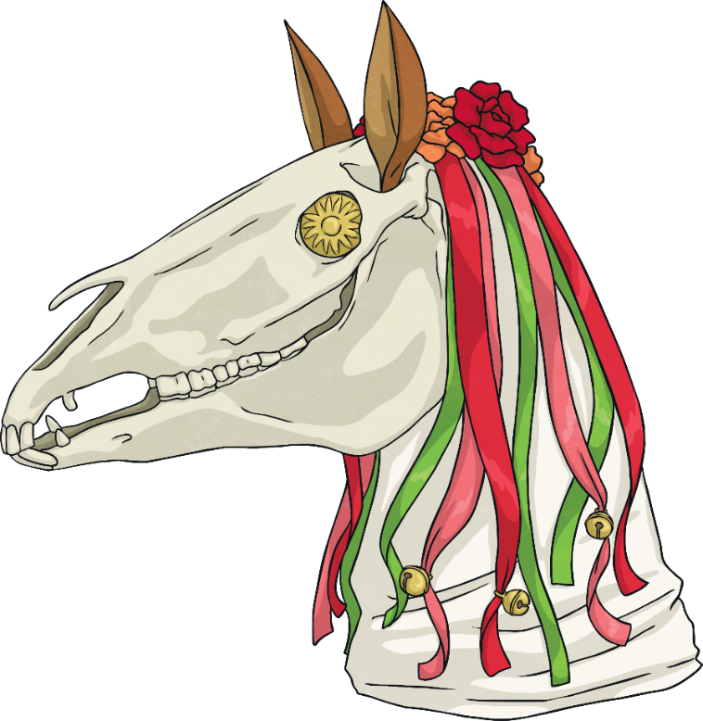
Where Was the Tradition of the Mari Lwyd Popular?
It was very popular in South Wales although the tradition was also practiced on Anglesey.
People celebrated wassailing in Glamorgan, in the villages of Coety, Bryncethin, Brynmenyn and Llangynwyd, near Maesteg. It would have been celebrated in other places too.
Today you can experience this tradition during the Christmas festivities at the St Fagans National Museum of History.

Slide 9
The Hen Galan (New Year)
Today we celebrate the New Year on the 1st of January.
Did You Know?
13th January
People used to celebrate the new year on:
Cwm Gwaun in Pembrokeshire still celebrates the New Year on this date.

Slide 10
What have you learnt about the tradition of wassailing and the Hen Galan (New Year)?
Discuss this with a partner.
How is it different to our celebrations today?
Why not have a go at acting out the fake battle (pwnco)?
You could also make your very own Mari Lwyd.

