Slide 2
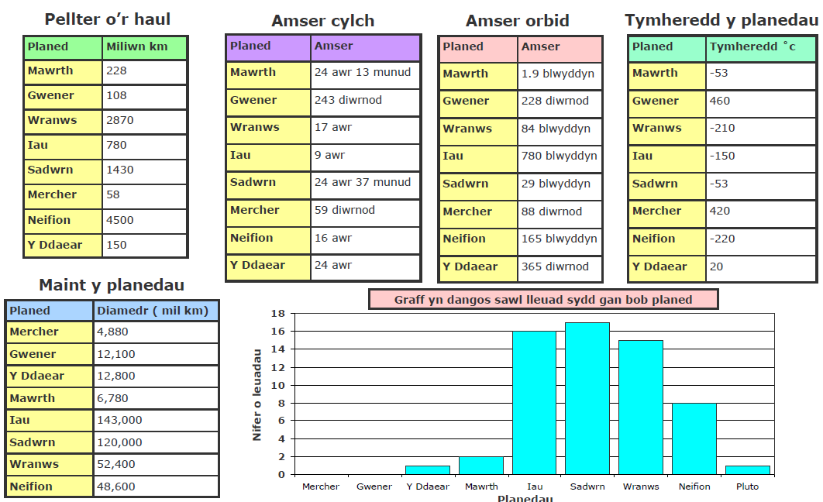
Y Planedau
Mat Iaith Y Planedau
Haul- the Sun
Lliw- colour
Pellter o’r haul- distance from the Sun
Amser Cylch- time taken to orbit
Amser orbid- time taken to orbit the Sun
Tymheredd- temperature
Maint y planedau- size of the planet
Diamedr- diameter (distance around the planet)
Lleuad- moon
Sawl lleuad? How many moons?
Planed fwyaf o’r haul- furthest planet from the Sun
Planed leiaf o’r haul- closest planet to the Sun
Oer- cold
Oeraf- coldest
Poeth-warm
Poethaf- warmest/hottest
Sawl? How many?

Slide 3
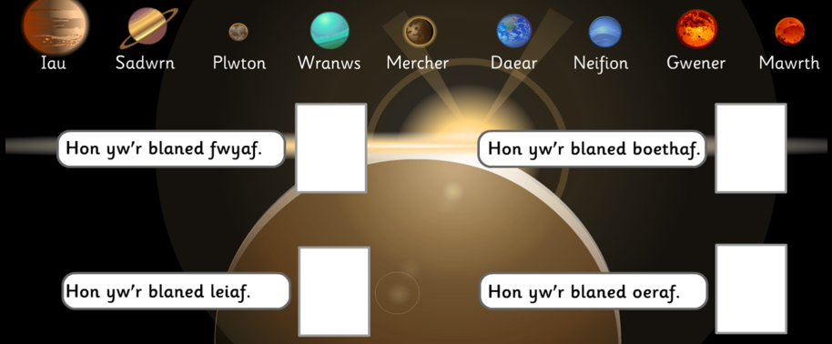

Slide 4
Y Planedau
Pa blaned ydy’r oeraf?_____________
Pa blaned ydy’r boethaf?___________
Sawl lleuad sy’n gyda Sadwrn?_______
Sawl lleuad sy’n gyda Neifion?_______

Slide 5
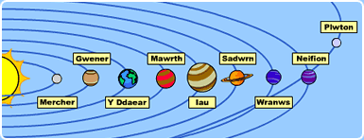
Dewiswch un blaned. Choose a planet.
Ysgrifennwch ffeithiau. Write some facts about the planet. Use the Mat Iaith to help you.
Enw__________________
Maint___________diamedr
Lliw___________________
Pellter o’r haul___________miliwn km
Sawl Lleuad__________
Amser cylch__________
Amser orbid__________
Tymheredd_____°C

