Slide 2
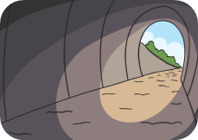
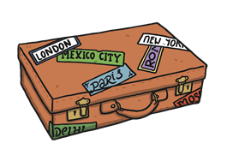
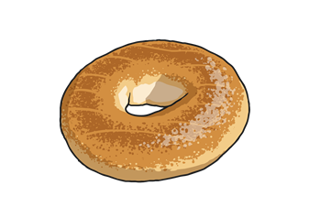
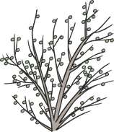
/l/ Spelt ‘el’
We have looked at the sound /l/ spelt with ‘le’ at the end of words.
The /l/ sound at the end of these words is spelt with ‘el’ instead.
camel
tunnel
squirrel
travel
towel
a
u
e
i
o
tinsel
bagel
hazel
vowel
jewel

Slide 3
Be Careful!
The sound /l/ sounds exactly the same whether it is spelt with ‘le’ or ‘el’ so be careful not to mix up the spellings!
Can you air write an ‘el’ with your finger?
Can you write an ‘le’ on your table or the carpet?
Can you write either an ‘el’ or an ‘le’ on a partner’s back?
Can they tell what letters you have written?

Slide 4
Here are this week’s spellings to practise.
camel
tunnel
squirrel
travel
towel
tinsel
bagel
hazel
vowel
jewel

