Slide 2
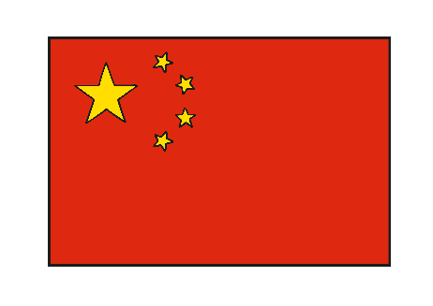
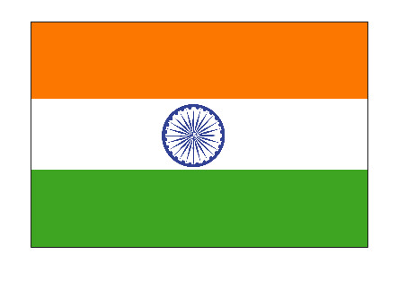
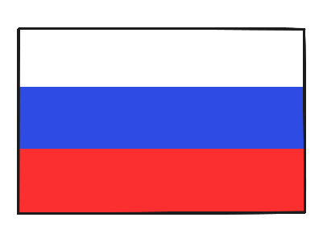
Countries
How many of these countries can you name?
UK
USA
Brazil
China
Kenya
Israel
Australia
India
Russia
Japan

Slide 3
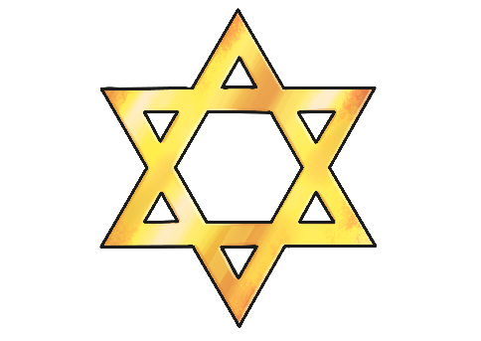
Religions
How many of these religions can you name?
Christianity
Judaism
Hinduism
Buddhism
Sikhism
Islam

Slide 4
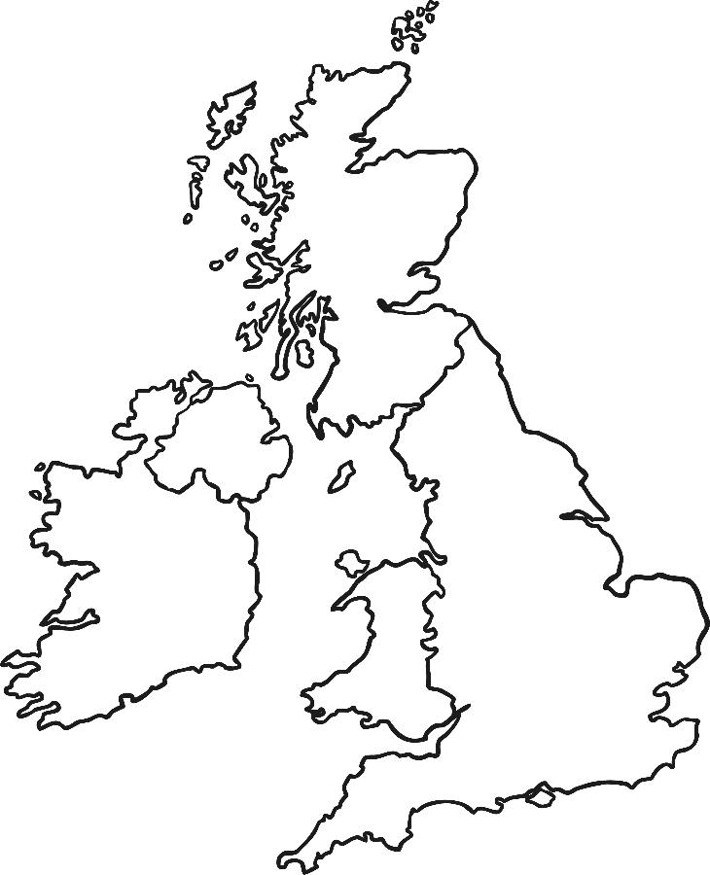
Mix and Match
Just like the flags of countries can share similar designs and colours, countries can also share many religions.

Slide 5
World Religion Day
History
It began in the United States in 1950 but is now celebrated worldwide.
It was initiated by the Spiritual Assembly of the Bahá’is (one of the world’s youngest religions which emphasizes the spiritual unity of all).
Annual
World Religion Day is held on the third Sunday in January every year.
Aim
To promote inter-faith understanding and harmony.
To unite everyone, whatever their faith.

Slide 6
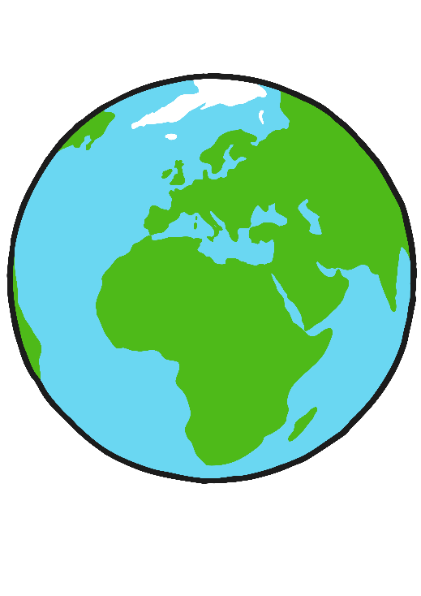
World Religion Day …continued
Events
A variety of events are held around the world and people are encouraged to acknowledge the similarities that different faiths have.
Special services are held around the world, celebrating similarities, creating understanding and showing how we can work together to create a better world.

Slide 7
One World
What similarities can you think of that religions might share?

Slide 8
Sikhism
I am a stranger to no one and no one is a stranger to me. I am a friend to all.
Christianity
In everything, do to others as you would have them do to you.
Hinduism
This is the sum of duty; do not do to others what would cause pain if done to you.
Love

Slide 9
Buddhism
Treat not others in ways that you would find hurtful.
Judaism
What is hateful to you, do not do to your neighbour.
This is the whole Torah; all the rest is commentary.
Islam
Not one of you truly believes until you wish for others what you wish for yourself.
Love

Slide 10
Reflection
What do these statements have in common?
Did you spot any words that are repeated?
DO
TO
OTHERS
WHAT
YOU
WOULD
WISH
FOR
ALL
NOT
ONE
What could you do to show this today?

